Slide 1
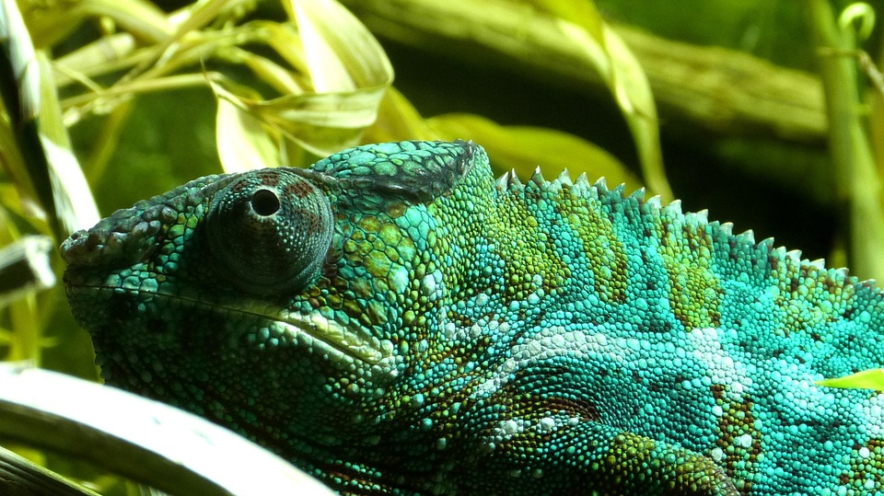
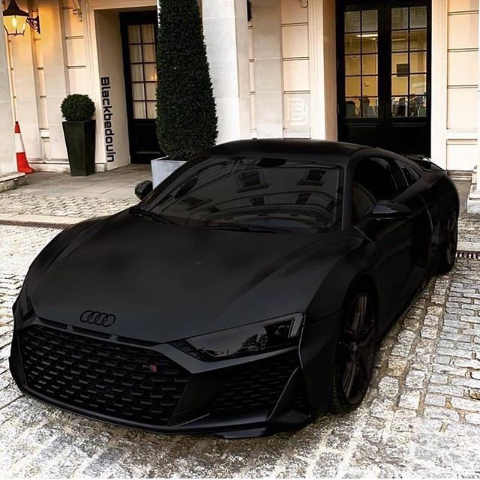
Vantablack & Chameleon Pigments

Slide 2
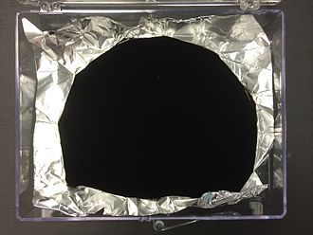
What is vantablack?
Vantablack is a substance made of carbon nanotubes, one of the blackest known substances absorbing more than 99.965% of radiation, created by researchers from the National Physical Laboratory

Slide 3
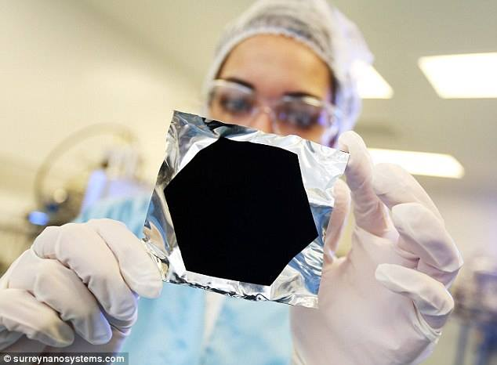
How does Vantablack work?
Due to the vertical orientation of the nanotubes, photons cannot be reflected after passing through them

Slide 4
Material use
The substance is planned to be used in the military and space agencies. Vantablack would be used as part of imaging equipment and to conceal aircraft

Slide 5
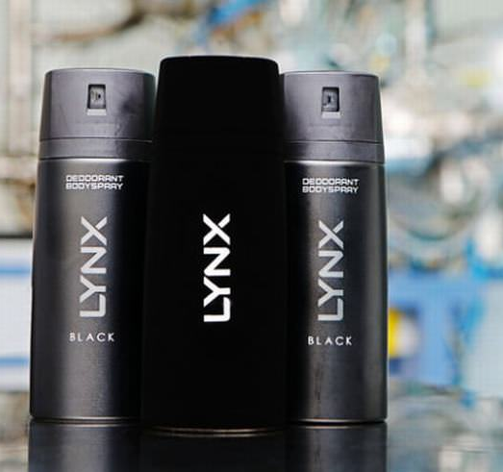
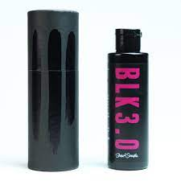
Commercial production
The first orders were delivered in July 2014. In 2015, production was scaled up to meet demand in the aerospace and defense sectors.

Slide 6
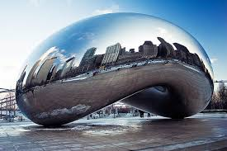
Interesting facts
Controversy arose when Surrey Nanosystems granted Anish Kapoor exclusive rights to use Vantablack in artistic applications.

Slide 7
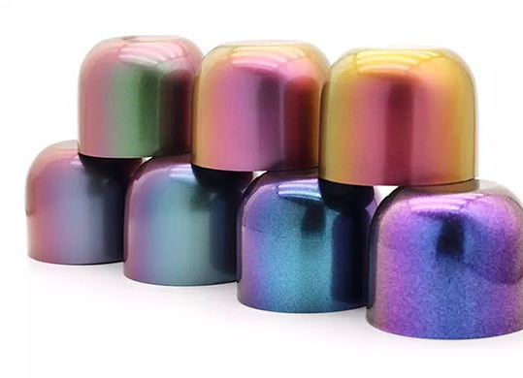
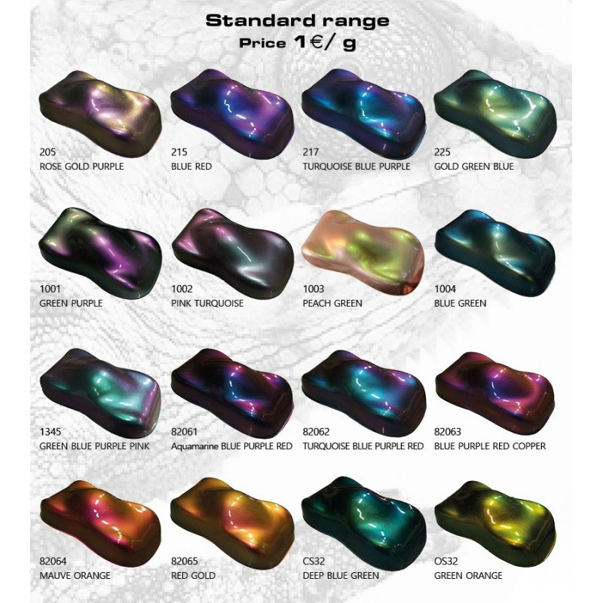
What is Chameleon Pigments
Light Interference: Chameleon Pigments use the way light waves mix to make lively colors. When we look from different angles or change the light, these pigments quickly change color.
Scattering Effects: The pigments spread light in different ways, creating fascinating color changes. As we move or the lighting shifts, the pigments react, making a visually impressive mix of colors.

Slide 8
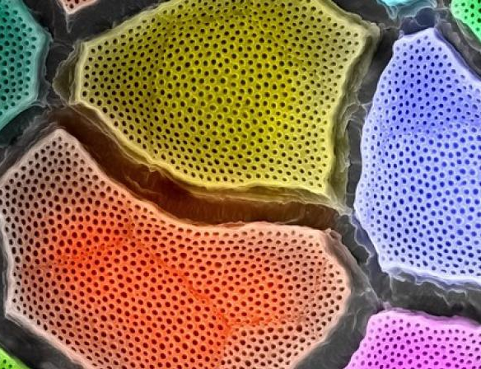
Components of Chameleon Pigments
Microscopic Particles
Interference Substances
Base Pigments
Additional Additives

Slide 9
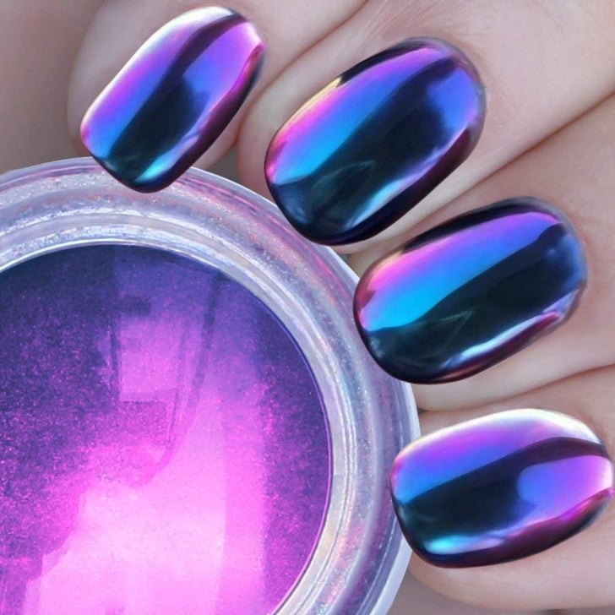
Commercial production

Slide 10
Challenges and Limitations
Production Costs
Color Stability
Industry-Specific Applications
Technological Complexity
Limitations in Color Combinations
Resistance to External Factors

