Slide 1
Types of licences
For Personal Protection, Protection of Persons and Property
For Sports Purposes
For Hunting Purposes
For Collecting Purposes
For Historical Reenactment

Slide 2
How to get them
In order to obtain the appropriate licence, we need to submit an application with medical examinations, documents on no criminal record, and the relevant documents depending on the licence chosen.

Slide 3
In the United States, access to guns is regulated by the Second Amendment to the Constitution. There is also diversity, as each state has the right to its own laws

Slide 4
In contrast, some of the regulations are imposed by federal legislation.
Minimum age 18,
No possession for mentally unbalanced persons and those convicted of domestic violence

Slide 5
There are only two licences in the US:
License to carry weapons
Open carry gun licence,
No distinction is made between licences for particular types of weapons or according to need

Slide 6
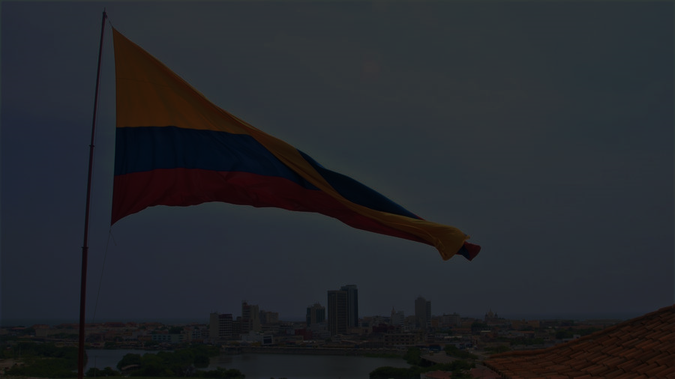
In Colombia, regulations on access to weapons are regulated by the Constitution To obtain such a permit, the following conditions must be met:
Minimum age 25,
Adequate medical examination,
No criminal record,
Justification of need (defence, security work)

Slide 7
In Colombia, two licences can be obtained, one to own a gun and one to carry it

Slide 8
In order to obtain such permits, you need to submit an application with a criminal record check and a letter to justify its issuance

